Slide 2
Topics
Overview of Web Programming
Introduction to PHP and MySQL
Installation and/or configuration of Apache, MySQL, PHP and phpMyAdmin on a Windows machine
Several simple PHP examples
Discount Calculator example from chapter 1

Slide 8
Web Programming
interpreter for each scripting language
server
web server
1. Someone creates a web page that contains server-side or client side code or both!
script processors
3. Web server locates page
4. Web server looks at the extension of the file to determine which scripting engine should process scripts. The scripting engine hands the code to the appropriate interpreter (or compiler) for execution.
2. User requests a page
client
browser
6. Browser processes client side scripts, interprets java code in applets, instantiates plugins/ActiveX controls
5. Web server packages “stuff” in the original page with the output generated by the script. The response is sent to user
7. Browser renders HTML and displays resulting page to user
Notes:
65,18

Slide 9
Web Programming
In this schematic, you can see that programming can happen on either the client side or the server side of this process – or both
Client –
What kinds of processing are likely to be done on the client?
What are some of the issues associated with programming on the client?
What are some of the technologies used in programming on the client?
If you only had time to learn one, which would you choose?

Slide 10
Web Programming
Server –
What kind of processing is best done on the server?
What are some of the issues associated with server side programming?
Why is it “easier” to program on the server rather than the client?
What are some of the technologies used to program on the server?
If you only had time to learn one, which would you choose?

Slide 11
PHP
All kinds of folks would tell you that php is the right server-side choice because
It’s open source
It’s fully functional yet lightweight and high performing
It’s cross platform
It’s widely used
It’s easy to learn

Slide 14
Web Development
We could have made other choices on the server
C# and ASP.NET
Java servlets and JSP
Cold Fusion
CGI and Perl
And then there are technologies and tools that are used on the client
xHTML, CSS and Javascript (you already know)
JQuery, Dojo (are Javascript frameworks)
Flash

Slide 15
Software Requirements
In order to do server side web development in php you need
Web server software
Software that “serves” web pages … responds to http requests for a page
Apache is most commonly installed with PHP
Database server software
Software that “serves” data
MySQL is most often installed with PHP
PHP interpreter
Software that works inside the web server to run php scripts embedded in web pages
A text editor
We’ll use Notepad++ or Aptana Studio 3. The textbook uses NetBeans which is more fully featured but requires you to create a project, like you do in Visual Studio. Too complex?
A browser
You can use any browser you want. The code is processed on the server side so your choice of browser will have absolutely no difference in the behavior of your server-side code.

Slide 16
Apache
Most of you will make a choice to install and use Apache rather than IIS as your web server
The installation is easier
Apache runs on Mac and Linux boxes as well as Windows boxes
Most shops who do PHP development are committed to the open source movement. They use Apache, PHP and MySQL together because all 3 started off as open source projects.
#AMP packages are available to easily install all 3 products for any operating system.

Slide 18
#AMP
#AMP packages are available to easily install all 3 products for any operating system.
LAMP – Linux
MAMP – Mac
WAMP – Windows
There are several appendices in the text that describe the installation of XAMPP on each operating system.
On campus we use a WAMP installation called WampServer.
If you work exclusively on your machine, install either #AMP server package.
If you work at home and on a campus machine in class, install WampServer at home so that you have the same software in both places.
The PHP is the same on either installation. The mechanics of using the server is the only thing that’s different.

Slide 19
WAMPServer
Do a google search for WAMPServer
Download and install it – accept all of the defaults
On some windows machines, IIS will already be installed (and the first web server "listens" for http reguests on port 80). In that case, you’ll have to configure apache to listen on port 81.
Open httpd.config from the WAMPServer menu on the task bar
Find the 2 occurrences of "80" in the file and change the port to 81.
Save the file
Start the Apache service from the WAMPServer menu

Slide 20
WAMPServer
Apache uses c:\wamp\www as the root for all web sites. XAMPP puts files in htdocs.
The important concept here is that all web server installations expect your web site files to be in a specific location on your machine.
Create a cs295p folder (if it’s not already there)
Ultimately you’ll want to make sure all 3 sample files run using Apache. I’ll show you the sample files in just a minute
Open a browser
Enter http://localhost/cs295p/lab1b.php as the url
OR http://localhost:81/cs295p/lab1b.php as the url. What's the :81 for? You won't need that at home unless you have both IIS and Apache installed
Can you find anything that tells you which web server software you're using right now?
Can you figure out any other way to browse your files using the WAMPServer menu?

Slide 21
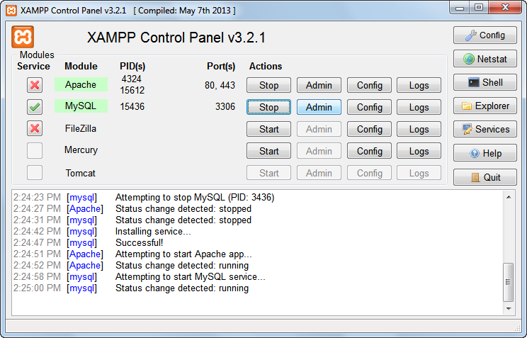

Slide 27
Just Enough PHP
Open a new file in Notepad++
Add the following code
<?php
echo "This is a test";
?>
Save it as lab1A.php in the cs295p directory
Run, Launch in Firefox – What happens? Why?
Open a browser
http://localhost/cs295p/lab1a.php - What happens?
View, Page Source – What happens? Why?
File, Open – What happens? Why?
Double click on the file in the operating system – What happens? Why?

Slide 28
Just Enough PHP
Open a new file
Add the following code
<?php
// phpinfo() is a predefined function in php
phpinfo();
?>
Save it as lab1B.php in the cs295p directory
How do you run it?
Why doesn't it work if you launch it in Notepad++? Double click on it from the file system?

Slide 29
Just Enough PHP
Open lab1cForm.php from the moodle web site
Open a new file
Add the following code
<?php
/* $_POST is an array (set of values with one name and lots of data)
that stores the data supplied by the user in a form.
The "key" or index in the array is the name attribute in html form.
*/
echo $_POST["studentName"] . "<br />";
echo $_POST["teacherName"] . "<br />";
echo $_POST["progLanguage"] . "<br />";
?>
Save it as lab1cOutput.php in the cs295 virtual directory
Open lab1cForm.php in a browser
Fill in the form
Press the Echo button

Slide 33
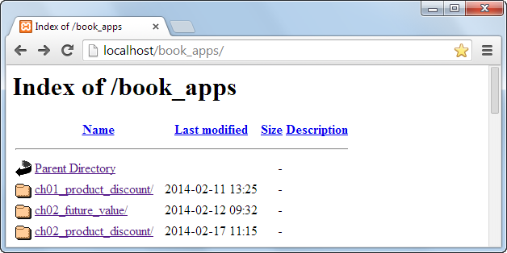

Slide 34
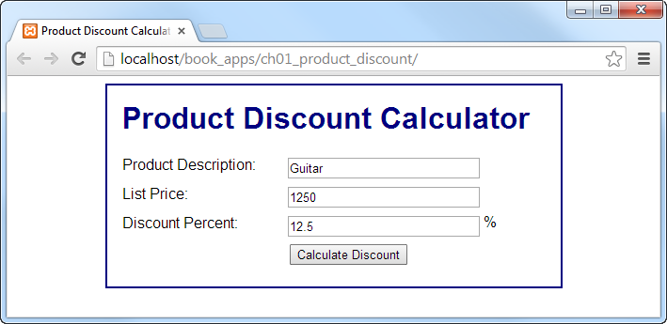

Slide 35
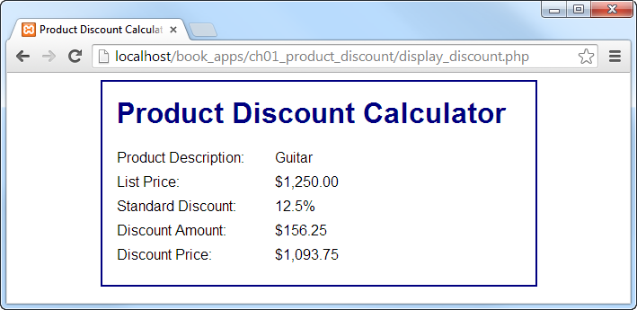

Slide 43
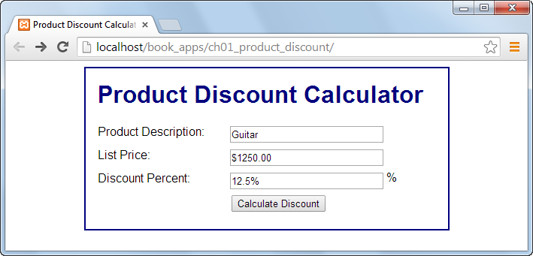

Slide 44
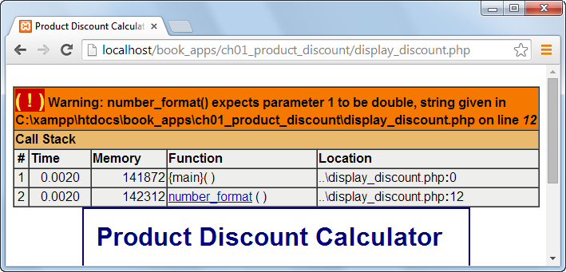

Slide 46
Lab 1
Lab 1 description gives more detail.
Part I
Research some web development technologies. Make ONE post to the forum on the site.
Part 2
Read Appendix in the text
Installation of Apache, PHP and MySQL
Oh, by the way, you have a reading quiz this week. It covers the appendix as well as chapter 1 in the text.
Install, configure and test with the 3 sample files on whatever machine you’re going to use for labs.
Work with the Discount Calculator app from chapter 1.
Exercises 1-1, 1-2 and 1-3 or 1-4 in the text.
Post all of it to citstudent and test each page to make sure that it all works!

Slide 47
Next Time
We’ll look at a slightly more complex web application.
Begin to read chapter 2 of the text.
Reading Quiz 2
Lab 2

